Slide 1
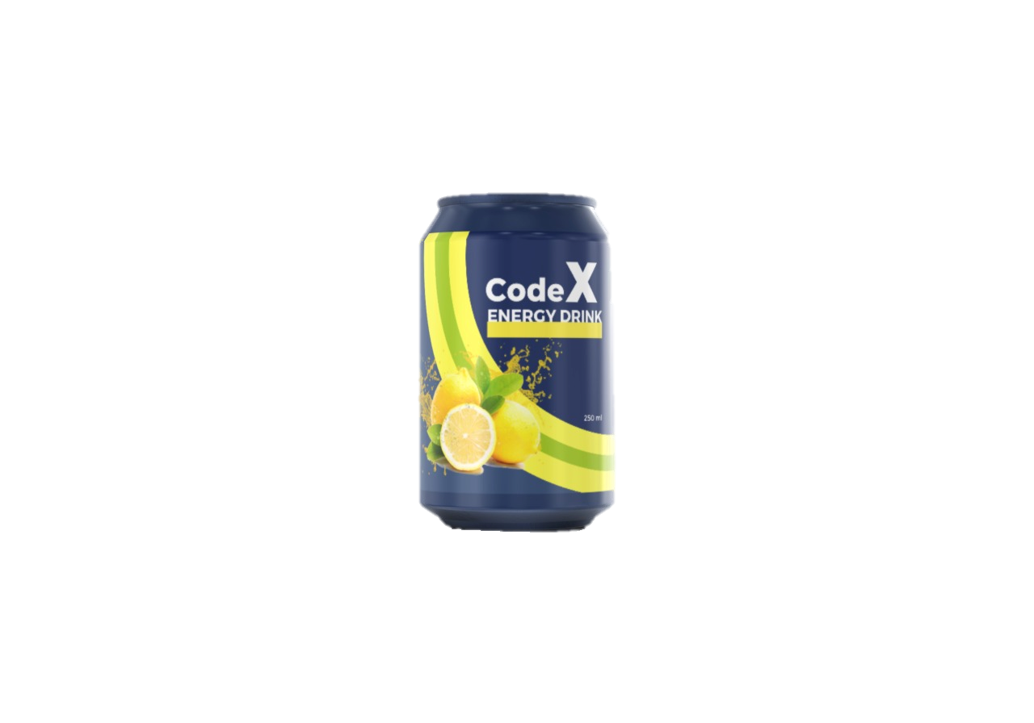










WELCOME
Codebasics Resume Project Challenge #6

Slide 2











CodeX HEALTH SAFETY SECURITY and ENVIRONMENT
X
Code
Beverage company
PLEASE REVIEW THE FOLLOWING FOR YOUR LOCATION
VIRTUAL MEETING REMINDERS
Do not take this call while driving, even when using headset or hands-free
Know the name of the building, room and floor number
Keep you microphones on mute unless you like to ask a question during the Q&A
You may submit questions at any time by typing a question in the chat box
Be familiar with sound of the fire alarm
Phone number for emergency
When using a headset, ensure you are still able to hear the fire alarm
Location of first aid kit and/or first aider
Please close all other applications to maintain focus

Slide 3



Agenda
CodeX HEALTH SAFETY SECURITY and ENVIRONMENT
PLEASE REVIEW THE FOLLOWING FOR YOUR LOCATION
VIRTUAL MEETING REMINDERS
Do not take this call while driving, even when using headset or hands-free
Know the name of the building, room and floor number
Keep you microphones on mute unless you like to ask a question during the Q&A
You may submit questions at any time by typing a question in the chat box
Be familiar with sound of the fire alarm
Phone number for emergency
When using a headset, ensure you are still able to hear the fire alarm
Location of first aid kit and/or first aider
Please close all other applications to maintain focus

Slide 4
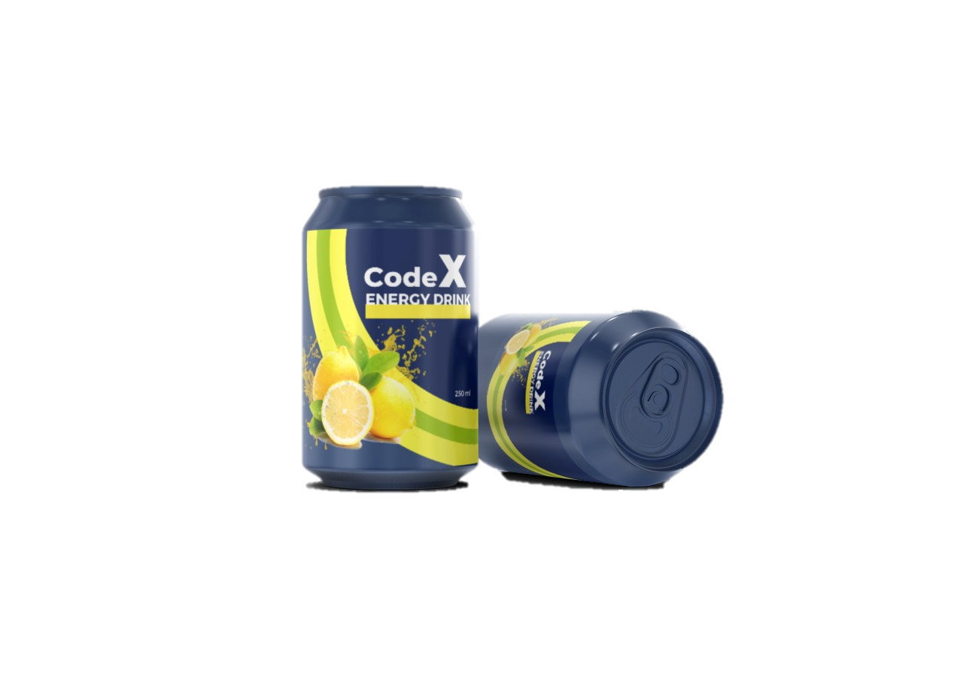



Introduction
Agenda
Introduction
Problem Statement
Primary Insights
Secondary Insights
Q & A

Slide 5


Introduction
CodeX a German beverage company that has recently entered the Indian market. With a focus on quality and taste, they have successfully launched their energizing drink in 10 cities across India.
It is known for its innovative product development and commitment to customer satisfaction. They use premium ingredients to create unique and captivating flavors.
The company also prioritizes environmental sustainability and aims to reduce its carbon footprint.
CodeX aims to establish a strong connection with Indian consumers through innovative marketing strategies.

Slide 6

Problem Statement
Key Positive Aspects
Refreshing and Energizing Experience
Diverse and Captivating Flavors
Premium Ingredients and Superior Taste
Potential Functional Benefits

Slide 7
Primary Insights
Problem Statement
Marketing team plays a vital role in boosting brand awareness, expanding market share, and driving product development.
Recently, they conducted an extensive survey across the 10 cities where the company launched its energizing drink.
The survey garnered an impressive response from 10K participants. Leading the charge in converting this valuable data into actionable insights.

Slide 8
Demographic Insights
Primary Insights
Demographic Insights
Consumer Preferences
Competition Analysis
Marketing Channels and Brand Awareness
Brand Penetration
Purchase Behaviour
Product Development

Slide 9
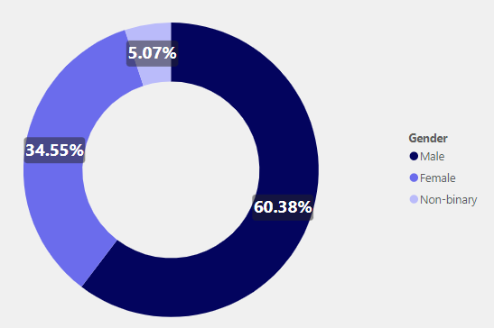
Demographic Insights
a) Who prefers energy drink more?
The survey results indicate that among different genders, Males exhibit a higher preference for energy drinks, comprising 60% of the total respondents.

Slide 10
Demographic Insights
a) Who prefers energy drink more?
The survey results indicate that among different genders, Males exhibit a higher preference for energy drinks, comprising 60% of the total respondents.
This finding underscores the significance of targeting the male demographic in marketing and promotional strategies for CodeX's energizing drink.

Slide 11
Demographic Insights
a) Who prefers energy drink more?
The survey results indicate that among different genders, Males exhibit a higher preference for energy drinks, comprising 60% of the total respondents.
This finding underscores the significance of targeting the male demographic in marketing and promotional strategies for CodeX's energizing drink.

Slide 12
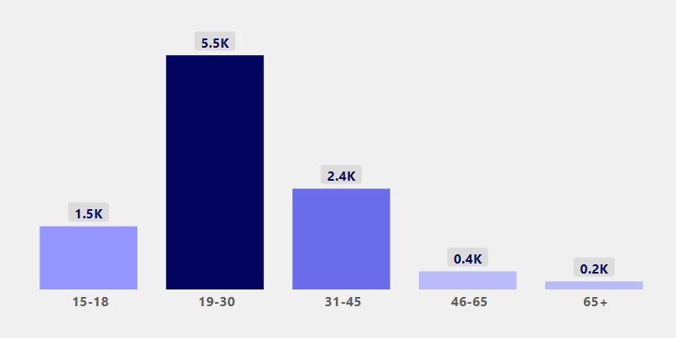
Demographic Insights
b) Which age group prefers energy drinks more?
With more than 50% preference among other age groups, the 19-30 age group emerges as a promising market segment for energizing drink.

Slide 13
Demographic Insights
b) Which age group prefers energy drinks more?
With more than 50% preference among other age groups, the 19-30 age group emerges as a promising market segment for energizing drink.
This presents a valuable opportunity for the company to focus its marketing efforts and tailor product messaging specifically to this age group.

Slide 14
Demographic Insights
b) Which age group prefers energy drinks more?
With more than 50% preference among other age groups, the 19-30 age group emerges as a promising market segment for energizing drink.
This presents a valuable opportunity for the company to focus its marketing efforts and tailor product messaging specifically to this age group.

Slide 15
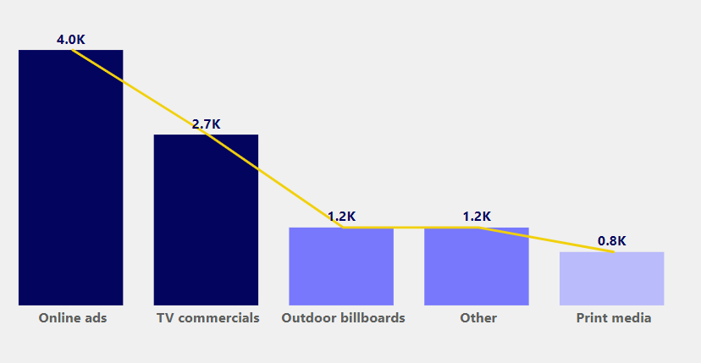
Consumer Preferences
Demographic Insights
c) Which type of marketing reaches the most Youth?
Online marketing has a greater reach among people compared to other channels

Slide 16
Consumer Preferences
Demographic Insights
c) Which type of marketing reaches the most Youth?
Online marketing has a greater reach among people compared to other channels
Leveraging the power of the internet, social media platforms, search engines, and other online channels, CodeX can extend its brand messaging and engage with a broader audience.

Slide 17
Consumer Preferences
Demographic Insights
c) Which type of marketing reaches the most Youth?
Online marketing has a greater reach among people compared to other channels
Leveraging the power of the internet, social media platforms, search engines, and other online channels, CodeX can extend its brand messaging and engage with a broader audience.

Slide 18
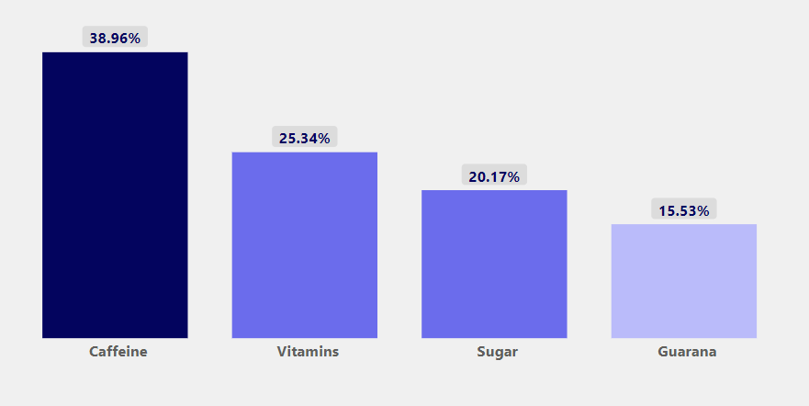
Consumer Preferences
a) What are the preferred ingredients of energy drinks among respondents?
Caffeine emerged as the most preferred ingredient with approximately 38% of respondents indicating a preference for it.

Slide 19
Consumer Preferences
a) What are the preferred ingredients of energy drinks among respondents?
Caffeine emerged as the most preferred ingredient with approximately 38% of respondents indicating a preference for it.
Following closely behind, Vitamins garnered a significant preference of around 25%.

Slide 20
Consumer Preferences
a) What are the preferred ingredients of energy drinks among respondents?
Caffeine emerged as the most preferred ingredient with approximately 38% of respondents indicating a preference for it.
Following closely behind, Vitamins garnered a significant preference of around 25%.
CodeX can capitalize on these insights by emphasizing the prominence of caffeine and vitamins in their
marketing communications, effectively appealing to consumers' desires for both an energy boost and enhanced wellness.

Slide 21
Consumer Preferences
a) What are the preferred ingredients of energy drinks among respondents?
Caffeine emerged as the most preferred ingredient with approximately 38% of respondents indicating a preference for it.
Following closely behind, Vitamins garnered a significant preference of around 25%.
CodeX can capitalize on these insights by emphasizing the prominence of caffeine and vitamins in their
marketing communications, effectively appealing to consumers' desires for both an energy boost and enhanced wellness.

Slide 22
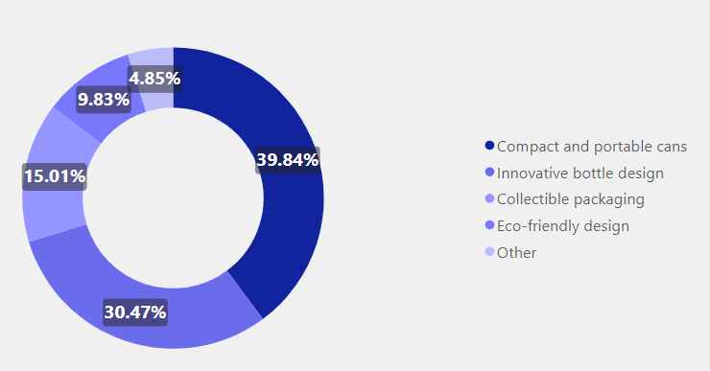
Competition Analysis
Consumer Preferences
b) What packaging preferences do respondents have for energy drinks?
Majority of the respondents have a preference for compact and portable cans when it comes to packing preferences.

Slide 23
Competition Analysis
Consumer Preferences
b) What packaging preferences do respondents have for energy drinks?
Majority of the respondents have a preference for compact and portable cans when it comes to packing preferences.
By providing compact cans, CodeX can cater to the on-the-go lifestyle of consumers, ensuring that they can enjoy the energizing drink anytime and anywhere.

Slide 24
Competition Analysis
Consumer Preferences
b) What packaging preferences do respondents have for energy drinks?
Majority of the respondents have a preference for compact and portable cans when it comes to packing preferences.
By providing compact cans, CodeX can cater to the on-the-go lifestyle of consumers, ensuring that they can enjoy the energizing drink anytime and anywhere.

Slide 25
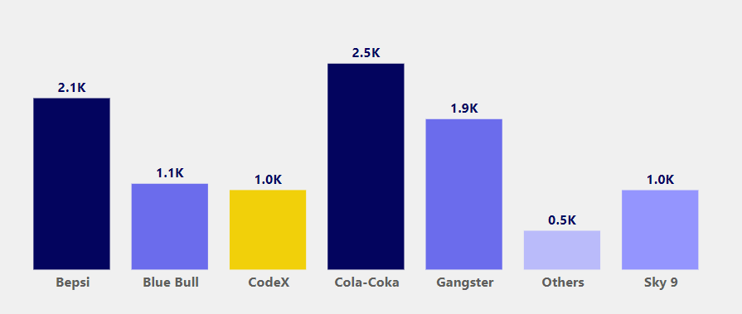
Competition Analysis
a) Who are the current market leaders?
In the Indian market, Cola Coka currently holds the leading position, while CodeX and Sky 9 are positioned at the same rank.

Slide 26
Competition Analysis
a) Who are the current market leaders?
In the Indian market, Cola Coka currently holds the leading position, while CodeX and Sky 9 are positioned at the same rank.
To become a strong competitor, CodeX can focus on product differentiation by introducing innovative flavors and functional benefits,
implement targeted marketing campaigns to increase brand awareness and engagement, and establish strategic partnerships with key influencers and distribution channels to expand market reach effectively.

Slide 27
Competition Analysis
a) Who are the current market leaders?
In the Indian market, Cola Coka currently holds the leading position, while CodeX and Sky 9 are positioned at the same rank.
To become a strong competitor, CodeX can focus on product differentiation by introducing innovative flavors and functional benefits,
implement targeted marketing campaigns to increase brand awareness and engagement, and establish strategic partnerships with key influencers and distribution channels to expand market reach effectively.

Slide 28
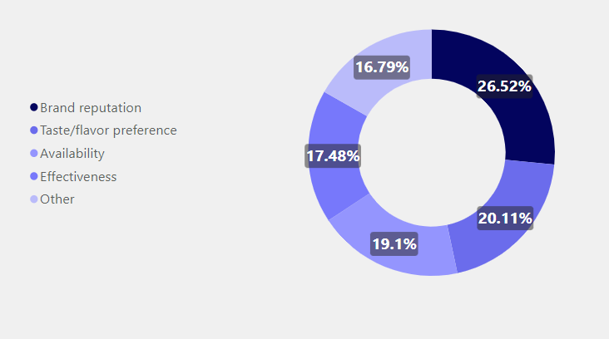
Marketing Channels and Brand Awareness
Competition Analysis
b) What are the primary reasons consumers prefer those brands over ours?
Brand reputation emerges as the primary factor driving the selection of an energy drink, with approximately 26.53% of the respondents highlighting its importance.

Slide 29
Marketing Channels and Brand Awareness
Competition Analysis
b) What are the primary reasons consumers prefer those brands over ours?
Brand reputation emerges as the primary factor driving the selection of an energy drink, with approximately 26.53% of the respondents highlighting its importance.
CodeX can capitalize on this insight by prioritizing efforts to build and enhance its brand reputation through consistent delivery of high-quality products, engaging marketing campaigns, and positive customer experiences.

Slide 30
Marketing Channels and Brand Awareness
Competition Analysis
b) What are the primary reasons consumers prefer those brands over ours?
Brand reputation emerges as the primary factor driving the selection of an energy drink, with approximately 26.53% of the respondents highlighting its importance.
CodeX can capitalize on this insight by prioritizing efforts to build and enhance its brand reputation through consistent delivery of high-quality products, engaging marketing campaigns, and positive customer experiences.

Slide 31
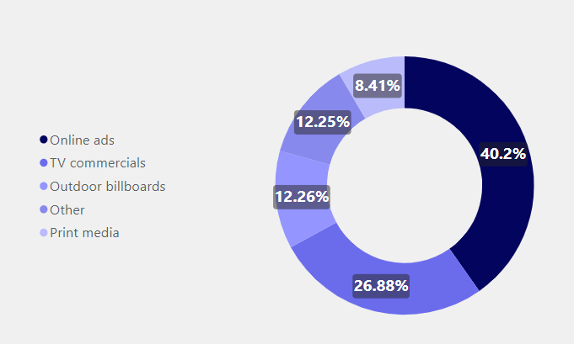
Marketing Channels and Brand Awareness
a) Which marketing channel can be used to reach more customers?
Online ads take the lead, capturing the attention of approximately 40% of the respondents, followed closely by TV commercials with 26% reach.

Slide 32
Marketing Channels and Brand Awareness
a) Which marketing channel can be used to reach more customers?
Online ads take the lead, capturing the attention of approximately 40% of the respondents, followed closely by TV commercials with 26% reach.
CodeX can optimize its marketing strategy by utilizing a combination of both online ads and TV commercials to enhance brand visibility and effectively reach a diverse range of potential customers.

Slide 33
Marketing Channels and Brand Awareness
a) Which marketing channel can be used to reach more customers?
Online ads take the lead, capturing the attention of approximately 40% of the respondents, followed closely by TV commercials with 26% reach.
CodeX can optimize its marketing strategy by utilizing a combination of both online ads and TV commercials to enhance brand visibility and effectively reach a diverse range of potential customers.

Slide 34
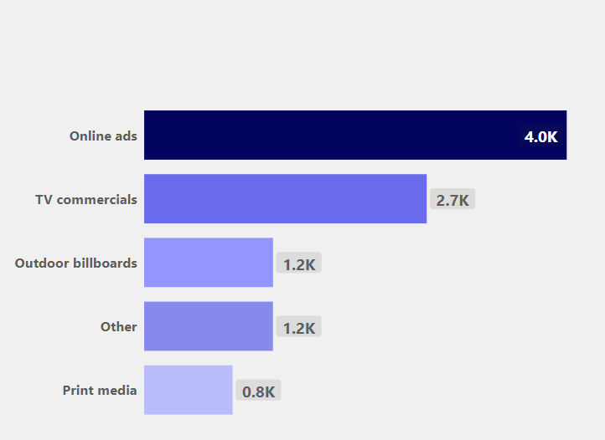
Brand Penetration
Marketing Channels and Brand Awareness
b) How effective are different marketing strategies and channels in reaching our customers?
When it comes to reaching customers effectively, online ads take the lead, providing a powerful and targeted approach to engage a specific audience. Online ads offer wide reach and precise audience targeting capabilities, allowing for effective brand visibility and customer engagement.

Slide 35
Brand Penetration
Marketing Channels and Brand Awareness
b) How effective are different marketing strategies and channels in reaching our customers?
When it comes to reaching customers effectively, online ads take the lead, providing a powerful and targeted approach to engage a specific audience. Online ads offer wide reach and precise audience targeting capabilities, allowing for effective brand visibility and customer engagement.
Following closely behind, TV commercials remain a valuable channel to reach a broader audience and generate brand awareness, especially for customers who may not be actively engaged in online platforms.

Slide 36
Brand Penetration
Marketing Channels and Brand Awareness
b) How effective are different marketing strategies and channels in reaching our customers?
When it comes to reaching customers effectively, online ads take the lead, providing a powerful and targeted approach to engage a specific audience. Online ads offer wide reach and precise audience targeting capabilities, allowing for effective brand visibility and customer engagement.
Following closely behind, TV commercials remain a valuable channel to reach a broader audience and generate brand awareness, especially for customers who may not be actively engaged in online platforms.

Slide 37

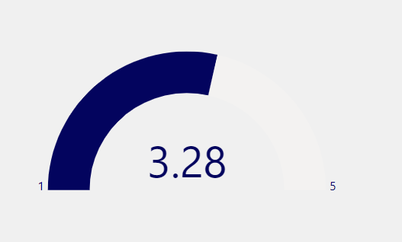
Brand Penetration
a) What do people think about our brand?
CodeX's energy drink received an average rating of 3.28 from the respondents, indicating a generally positive reception.

Slide 38

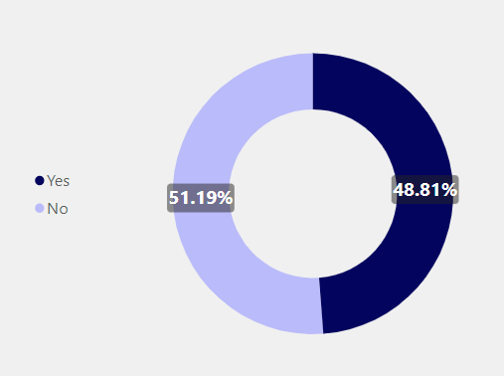
Brand Penetration
a) What do people think about our brand?
CodeX's energy drink received an average rating of 3.28 from the respondents, indicating a generally positive reception.
However, it's worth noting that a significant portion, approximately 55.5%, of the respondents reported not having heard about the energy drink.

Slide 39
Brand Penetration
a) What do people think about our brand?
CodeX's energy drink received an average rating of 3.28 from the respondents, indicating a generally positive reception.
However, it's worth noting that a significant portion, approximately 51%, of the respondents reported not having heard about the energy drink.
This highlights the need to enhance brand awareness and expand marketing efforts to reach a wider audience.

Slide 40
Brand Penetration
a) What do people think about our brand?
CodeX's energy drink received an average rating of 3.28 from the respondents, indicating a generally positive reception.
However, it's worth noting that a significant portion, approximately 51%, of the respondents reported not having heard about the energy drink.
This highlights the need to enhance brand awareness and expand marketing efforts to reach a wider audience.

Slide 41
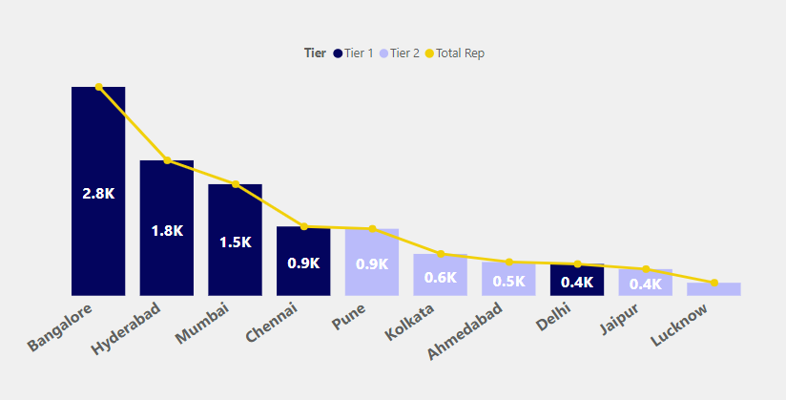
Purchase Behavior
Brand Penetration
b) Which cities do we need to focus more on?
The survey results indicate that even in tier 1 cities, Chennai has the lowest consumption at 9% and Delhi at 4%.

Slide 42
Purchase Behavior
Brand Penetration
b) Which cities do we need to focus more on?
The survey results indicate that even in tier 1 cities, Chennai has the lowest consumption at 9% and Delhi at 4%.
Moreover, all tier 2 cities reported consumption levels below 10%.

Slide 43
Purchase Behavior
Brand Penetration
b) Which cities do we need to focus more on?
The survey results indicate that even in tier 1 cities, Chennai has the lowest consumption at 9% and Delhi at 4%.
Moreover, all tier 2 cities reported consumption levels below 10%.
By directing marketing efforts towards tier 2 cities, CodeX can tap into these relatively untapped markets, increase brand visibility, and drive higher product adoption.

Slide 44
Purchase Behavior
Brand Penetration
b) Which cities do we need to focus more on?
The survey results indicate that even in tier 1 cities, Chennai has the lowest consumption at 9% and Delhi at 4%.
Moreover, all tier 2 cities reported consumption levels below 10%.
By directing marketing efforts towards tier 2 cities, CodeX can tap into these relatively untapped markets, increase brand visibility, and drive higher product adoption.

Slide 45
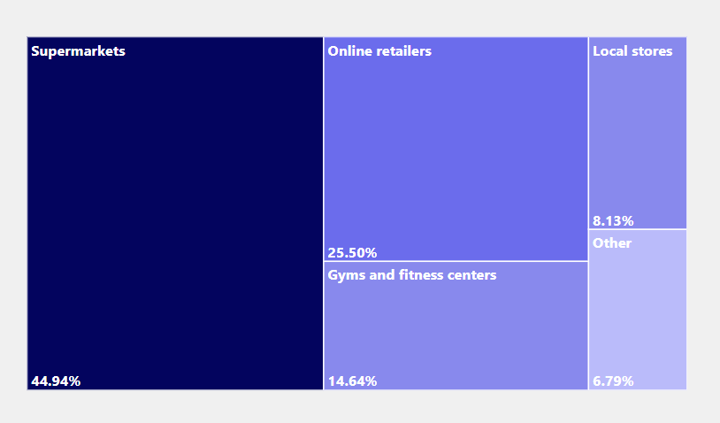
Purchase Behavior
a) Where do respondents prefer to purchase energy drinks?
Super markets has the preferred option with 45% of respondents, followed closely by online retailers at 25%.

Slide 46
Purchase Behavior
a) Where do respondents prefer to purchase energy drinks?
Super markets has the preferred option with 45% of respondents, followed closely by online retailers at 25%.
By ensuring product availability and visibility in supermarkets & Online, CodeX can have good portion of the market.

Slide 47
Purchase Behavior
a) Where do respondents prefer to purchase energy drinks?
Super markets has the preferred option with 45% of respondents, followed closely by online retailers at 25%.
By ensuring product availability and visibility in supermarkets & Online, CodeX can have good portion of the market.

Slide 48
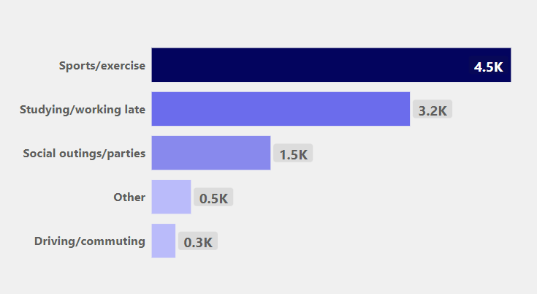
Purchase Behavior
b) What are the typical consumption situations for energy drinks among respondents?
Among the respondents, energy drinks were commonly consumed in two primary situations, during sports/exercise and while studying/working late.

Slide 49
Purchase Behavior
b) What are the typical consumption situations for energy drinks among respondents?
Among the respondents, energy drinks were commonly consumed in two primary situations, during sports/exercise and while studying/working late.

Slide 50
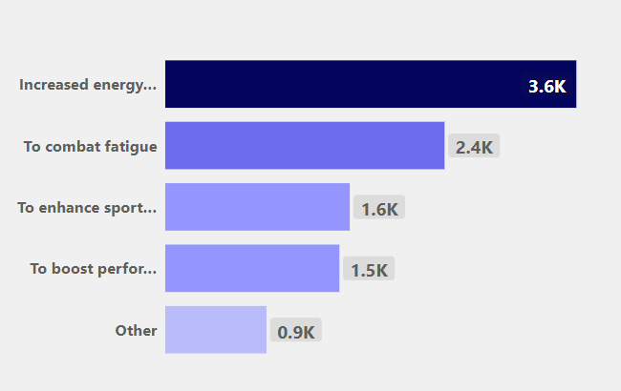

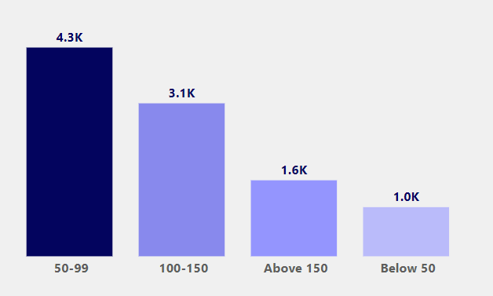
Product Development
Purchase Behavior
c) What factors influence respondents' purchase decisions, such as price range and limited edition packaging?
The primary reason for consuming energy drinks, as reported by the respondents, is to enhance energy levels and improve focus.

Slide 51

Product Development
Purchase Behavior
c) What factors influence respondents' purchase decisions, such as price range and limited edition packaging?
The primary reason for consuming energy drinks, as reported by the respondents, is to enhance energy levels and improve focus.
In addition, a significant majority of the respondents expressed a preference for energy drink prices ranging between Rs 50-90.

Slide 52
Product Development
Purchase Behavior
c) What factors influence respondents' purchase decisions, such as price range and limited edition packaging?
The primary reason for consuming energy drinks, as reported by the respondents, is to enhance energy levels and improve focus.
In addition, a significant majority of the respondents expressed a preference for energy drink prices ranging between Rs 50-90.

Slide 53
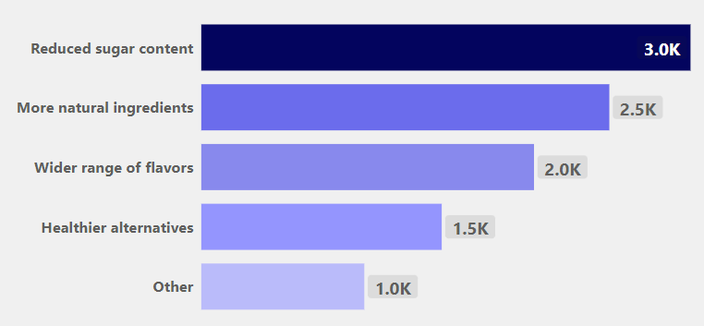
Secondary Insights
Product Development
a) Which area of business should we focus more on our product development?
By reducing sugar content, adding more natural ingredients, and offering a wide range of flavors, CodeX can create a healthier option for consumers.

Slide 54
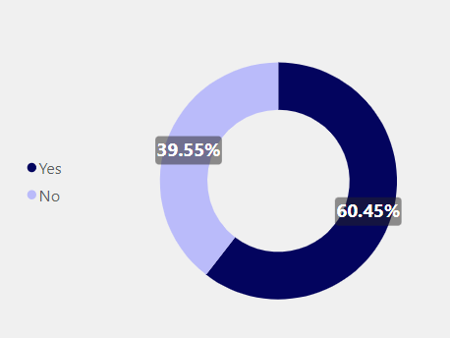
Secondary Insights
Product Development
a) Which area of business should we focus more on our product development?
By reducing sugar content, adding more natural ingredients, and offering a wide range of flavors, CodeX can create a healthier option for consumers.
60%, expressed concern about the health impacts of energy drinks, while 40% did not share the same level of concern. This highlights the importance of addressing consumer apprehensions and ensuring transparency regarding the health effects of CodeX's energizing drink.

Slide 55
Secondary Insights
Product Development
a) Which area of business should we focus more on our product development?
By reducing sugar content, adding more natural ingredients, and offering a wide range of flavors, CodeX can create a healthier option for consumers.
60%, expressed concern about the health impacts of energy drinks, while 40% did not share the same level of concern. This highlights the importance of addressing consumer apprehensions and ensuring transparency regarding the health effects of CodeX's energizing drink.

Slide 56
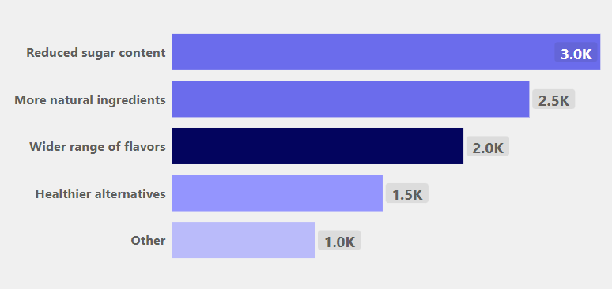
Secondary Insights
1) Which area of business should we focus more on our product development?
Flavour Enhancement
As per feedback regarding taste preferences and consider introducing new flavor variants or refining the existing ones based on consumer preferences.
The addition of citrus flavors can provide a tangy and uplifting twist to the beverage, making it even more appealing as a revitalizing and energizing option.

Slide 57
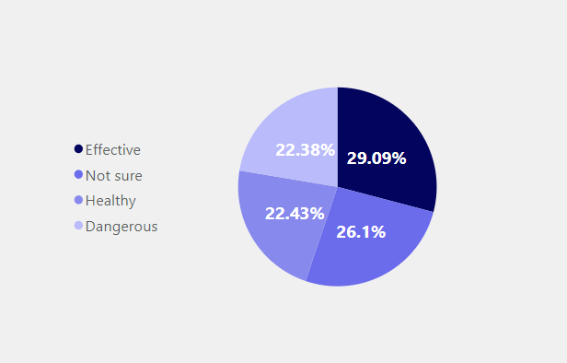
Secondary Insights
1) Which area of business should we focus more on our product development?
Nutritional Value
According to the survey results, a significant portion of consumers, approximately 22.43%, expressed a preference for healthier beverage options that provide an energy boost. This finding indicates that there is a strong demand for drinks that not only provide an energy lift but also offer health benefits.
Consider Nutritional aspects, incorporating additional health benefits, such as natural ingredients, reduced sugar content, or fortifying the drink with vitamins and minerals.

Slide 58
Secondary Insights
2) What should be the ideal price of our product?
Based on the survey responses, approximately 4.3K consumers are willing to accept pricing between 50 to 99 rupees, while 1K consumers are open to pricing below 50 rupees for the energizing drink.
These findings indicate that there is a significant portion of the target market who are open to paying a moderate price for the product. CodeX can consider pricing the energizing drink within the range of 50 to 99 rupees to align with consumer expectations and capture a larger market share.

Slide 59

Secondary Insights
3) What kind of marketing campaigns, offers, and discounts we can run?
Online Advertising Campaigns : Utilize targeted online advertising campaigns through platforms such as social media, search engines, or display networks. Tailor the messaging to highlight the product's unique features, health benefits, and competitive pricing to attract potential customers.

Slide 60

Secondary Insights
3) What kind of marketing campaigns, offers, and discounts we can run?
Influencer Partnerships : Collaborate with popular social media influencers, fitness enthusiasts, or health experts who align with the target audience's interests and values.
These influencers can promote the product through sponsored content, reviews, or giveaways to increase brand awareness and credibility.

Slide 61
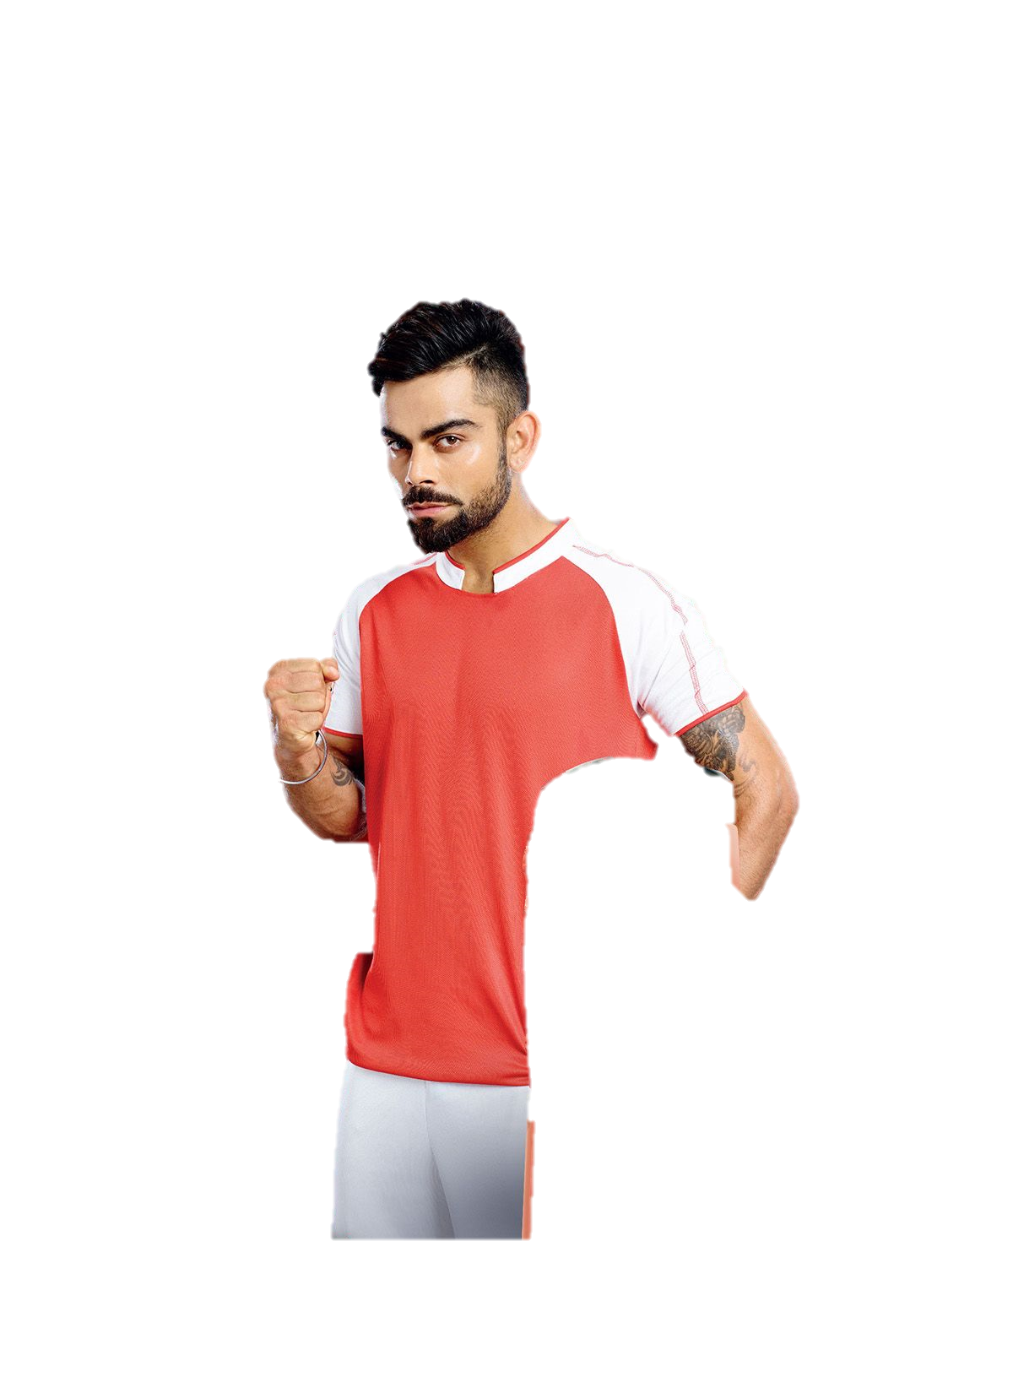


Secondary Insights
3) What kind of marketing campaigns, offers, and discounts we can run?
Online Contests and Giveaways : Launch engaging online contests on social media platforms, encouraging users to participate and share their experiences with CodeX's drink.
Offer prizes such as product bundles, exclusive merchandise, or fitness-related experiences to incentivize engagement and create a buzz around the product.

Slide 62

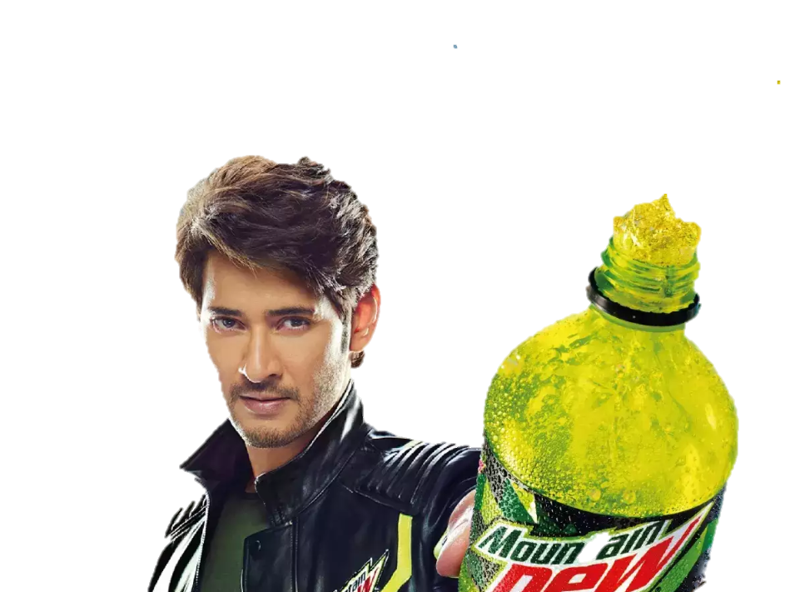

Secondary Insights
4) Who can be a brand ambassador, and why?
Virat Kohli is an ideal brand ambassador for CodeX because he embodies the epitome of fitness in our country and is widely recognized as a popular and accomplished athlete.
By associating with Virat Kohli, CodeX can inspire consumers to prioritize their health and fitness, while also benefiting from his immense popularity and influence to boost brand visibility and credibility.

Slide 63

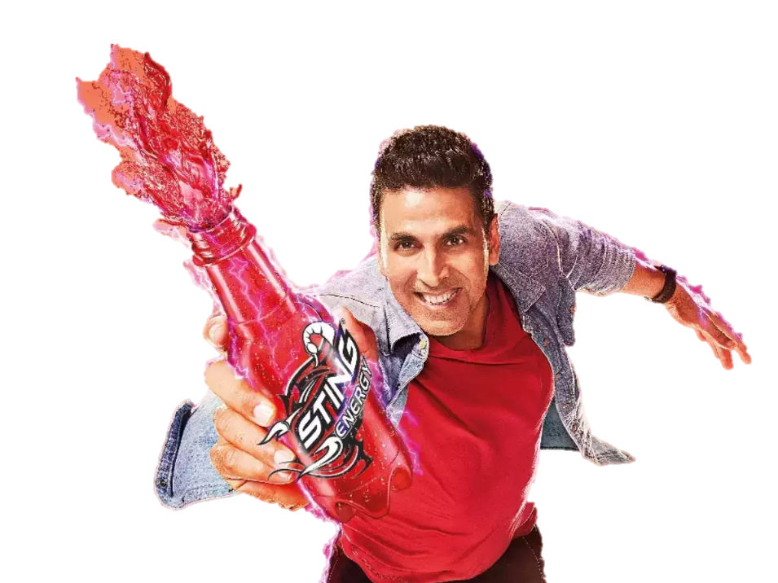
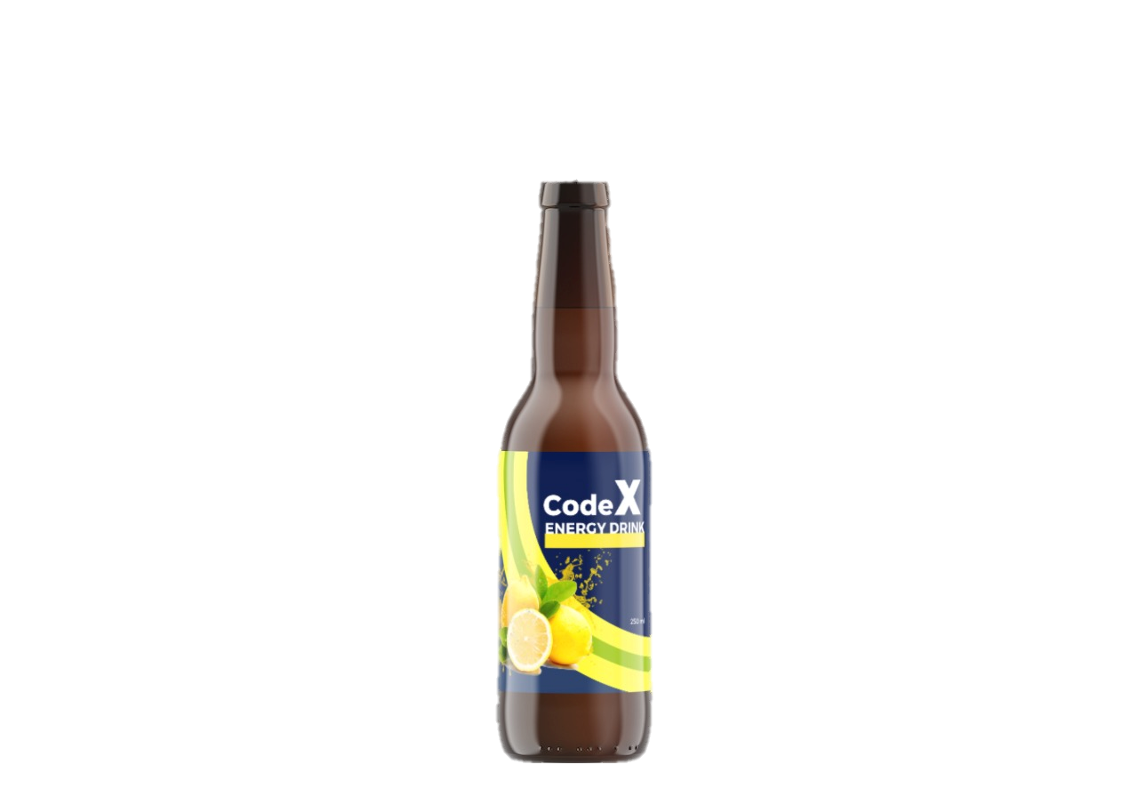
Secondary Insights
4) Who can be a brand ambassador, and why?
Mahesh Babu's impressive career and commitment to fitness with the target audience, establishing a strong connection and credibility.
By partnering with Mahesh Babu, CodeX can effectively tap into the South Indian market, leveraging his star power to drive brand visibility and build a loyal customer base.

Slide 64
Secondary Insights
4) Who can be a brand ambassador, and why?
Akshay Kumar have a strong fan following in the North states.
By associating with Akshay Kumar, CodeX can effectively hold the North Indian market, leveraging his star power to enhance brand recognition

Slide 65


Secondary Insights
5) Who should be our target audience, and why?
Fitness Enthusiasts : Focusing on fitness enthusiasts, including gym-goers, athletes, and individuals engaged in regular physical activities, can be a strategic choice.
Q& A
Active On-the-Go Consumers : Targeting individuals who lead busy and active lifestyles, such as frequent travellers, outdoor enthusiasts, or busy parents, can be advantageous.

Slide 66
Question & Answer
Q& A

Slide 67
THANK YOU

